Slide 1
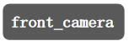
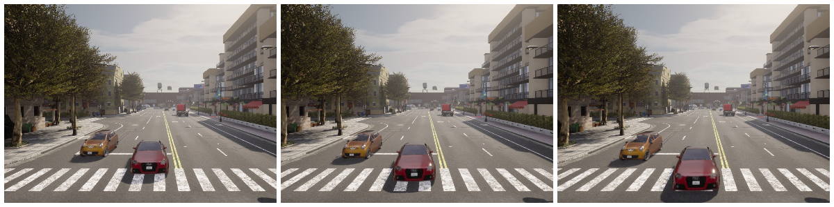
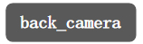
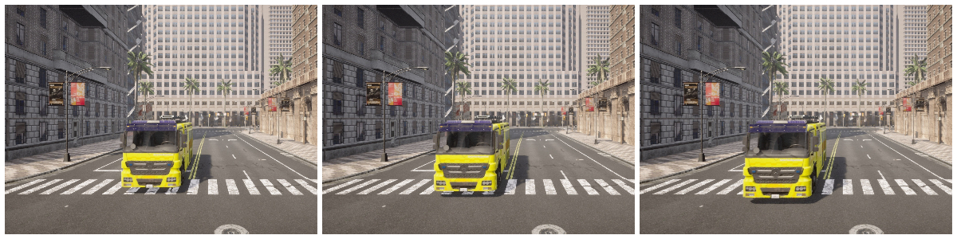
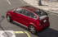
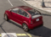
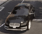
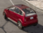
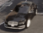
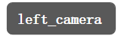
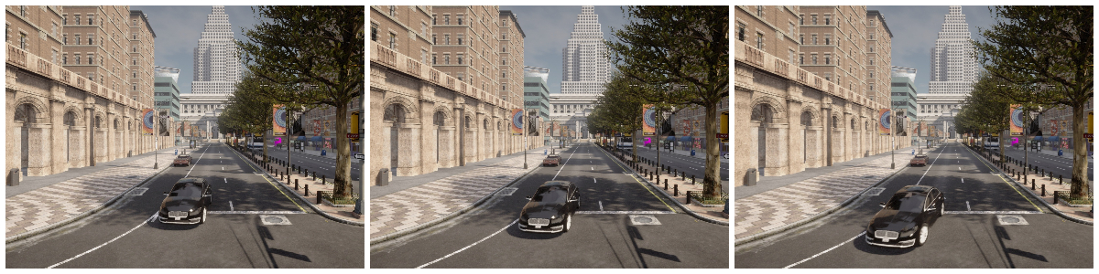
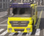
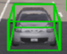
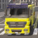
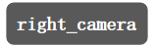
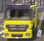
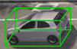
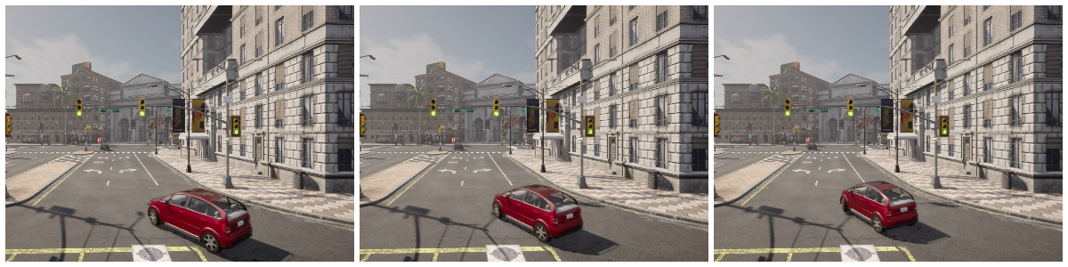
·
·
·

Slide 2
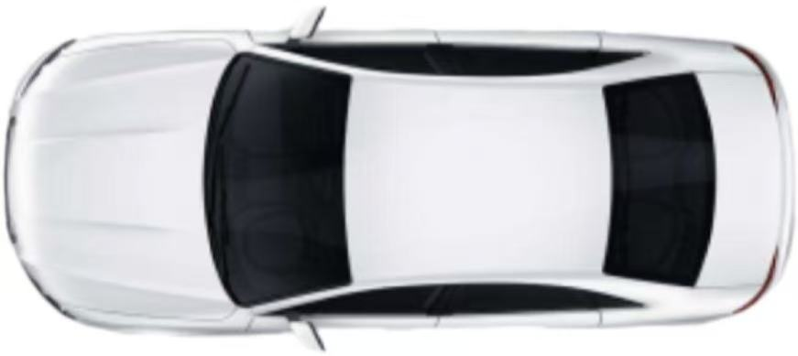
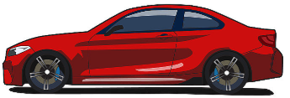
Upward
X-axis
Y-axis
Left-Camera(2.62m)
Z-axis
Front-Left-Camera(2.62m)
4m
4m
Front-Camera(2.62m)
7m
LiDAR(0.82m)
Back-Camera(2.62m)
7m
4m
4m
Right-Camera(2.62m)
Front-Right-Camera(2.62m)
(a) Sensor placement
Ego-vehicle coordinate system
LiDAR coordinate system
Transformation matrix
JPDA
Carla coordinate
O(0,0,0)
P₂(x₂,y₂,z₂)
P(x₀,y₀,z₀)
P₁(x₁,y₁,z₁)
(b) Coordinate transformation

Slide 3
Intersection R₁
Trajectory T₁
Intersection R₂
Trajectory T₂
Intersection R₃
Trajectory T₃
P₁(t_{1_end})
P₂(t_{2_start})
NAVIGATION ALGORITHM FRAMEWORK
Topological Map Input
Start/Goal Input
A* Algorithm
Trajectory Interpolation
C₁: P₁->P₂
Position Identification
Feasibility Check
Yes
Trajectory Generation
No
Lane Change Strategy
C₂: P₂->P₃
Exception
Termination
Time Axis t:
T₁
>>>>>C₁>>>>>
T₂
>>>>>C₂>>>>>
T₃

Slide 4
front_camera
back_camera
left_camera
·
·
·
right_camera

Slide 5
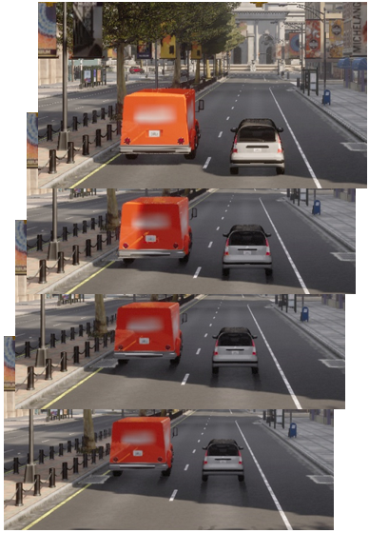
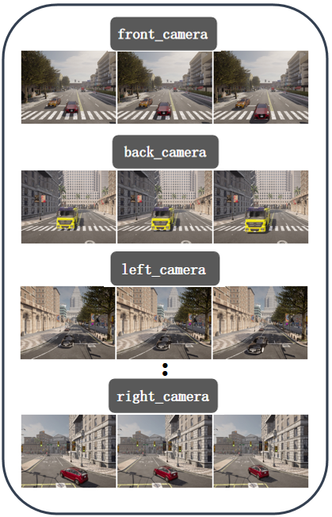
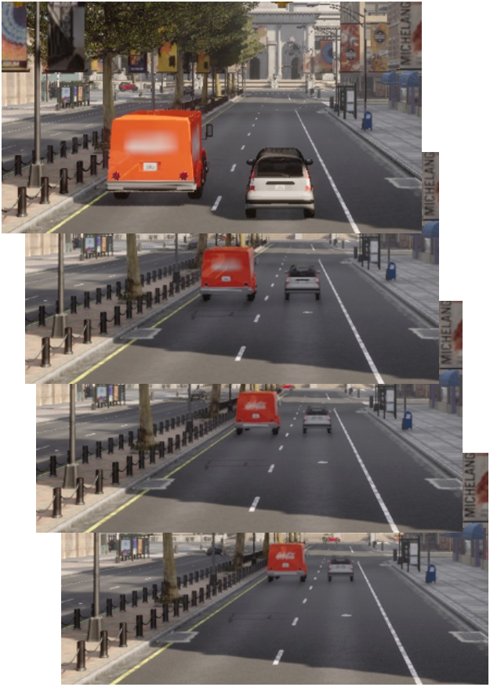
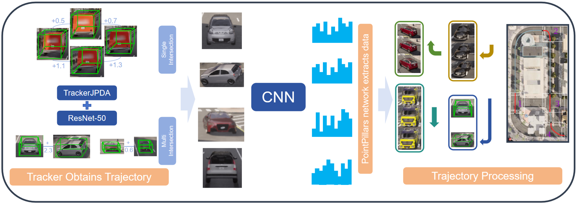
Urban Vehicle Digital Twin
original scene
video streams
object tracking
feature extraction
trajectory restoration
twin scene

Slide 6
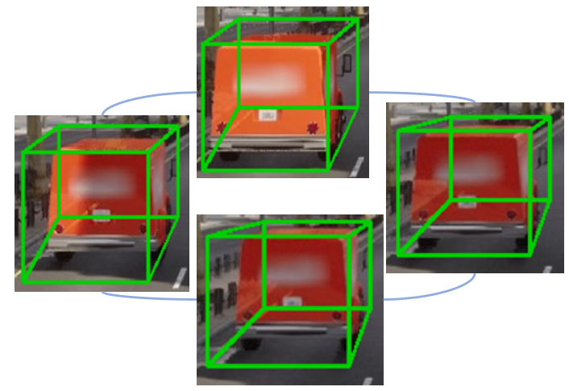
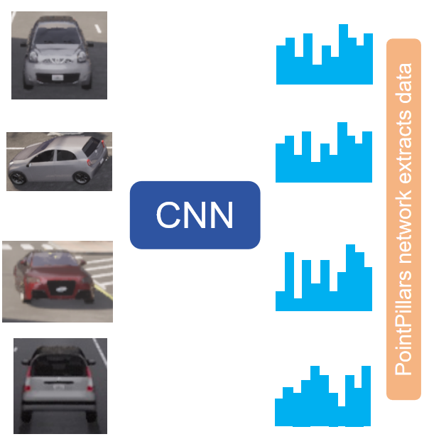
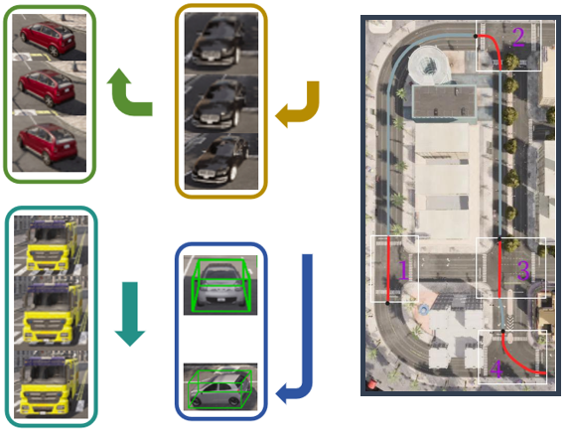
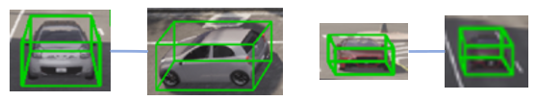
+0.5
+0.7
Single Intersection
+1.1
+1.3
TrackerJPDA
ResNet-50
+
2.3
+
0.6
Multi Intersection
Tracker Obtains Trajectory
Trajectory Processing

Slide 7
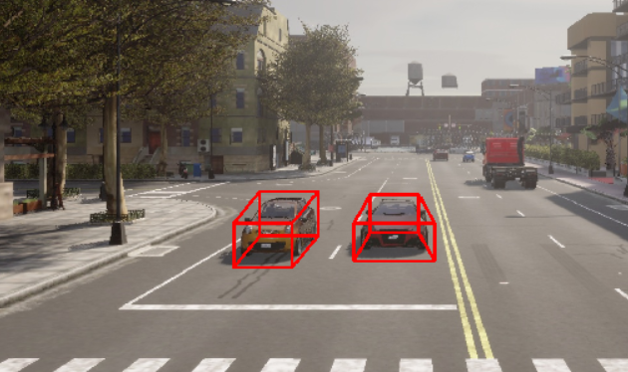
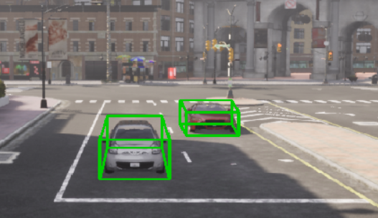
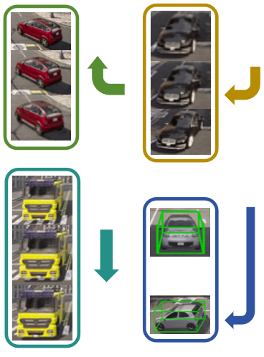
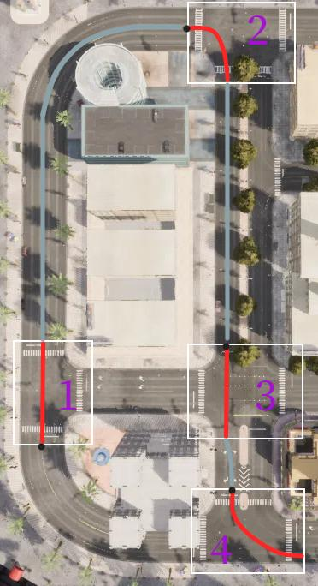
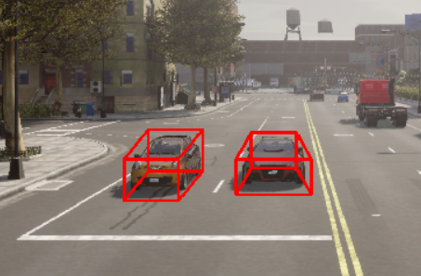
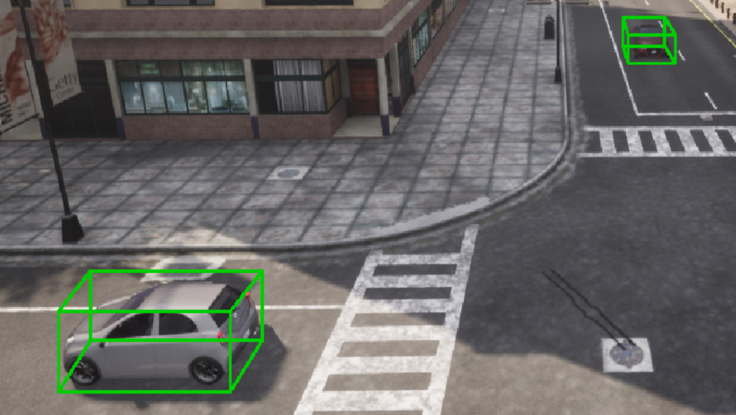

Slide 8
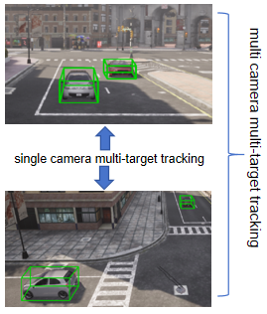
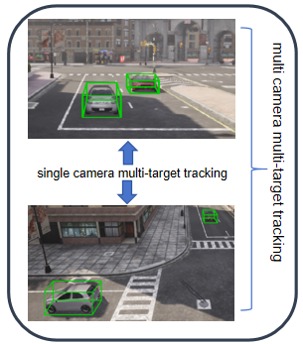
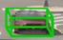
multi camera multi-target tracking
single camera multi-target tracking

Slide 9
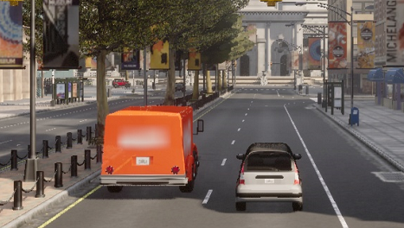
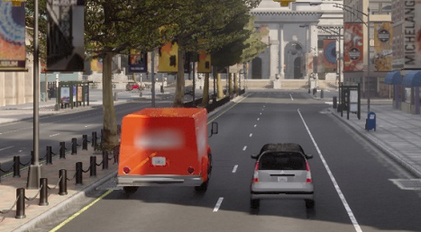
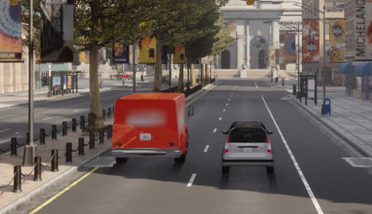
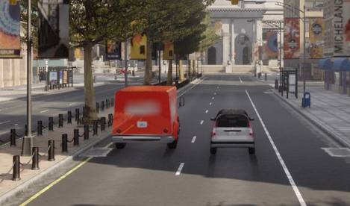

Slide 10
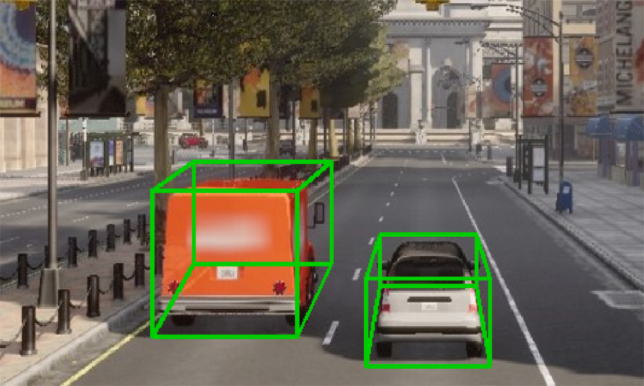
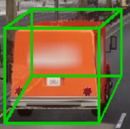
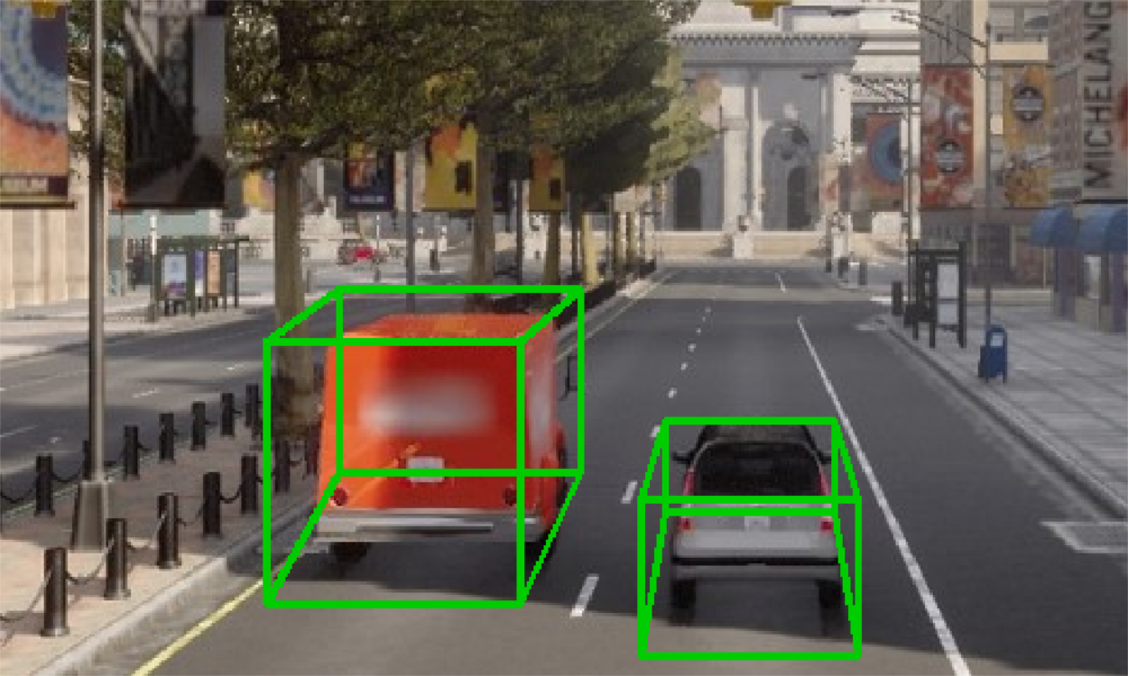
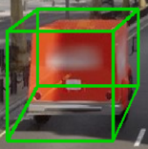
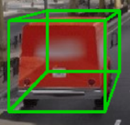
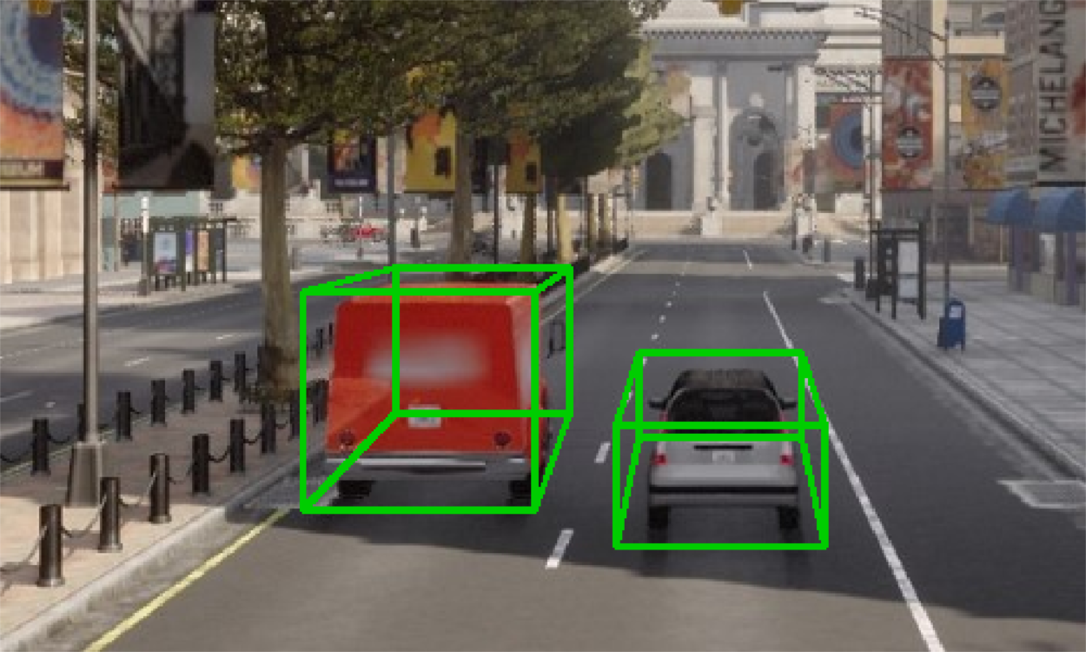
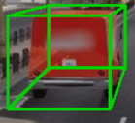
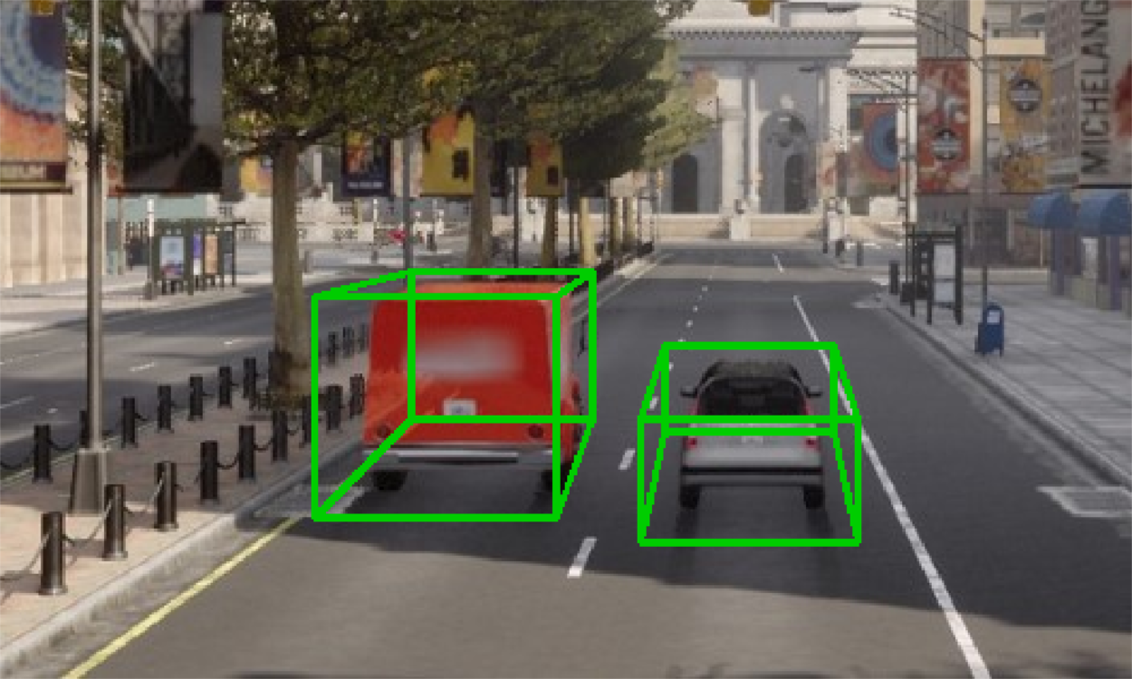

Slide 11
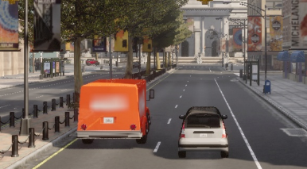




Slide 12





CNN
PointPillars network extracts data

Slide 13








Slide 15


UVDT
PointPillars Network
TrackerJPDA
ResNet-50
PID Controller

Slide 16


UVDT
vehicle identification from point cloud data
TrackerJPDA
getting vehicle trajectory
feature extraction for vehicles
control of vehicle movement
PointPillars Network
ResNet-50
PID Controller

